Slide 1
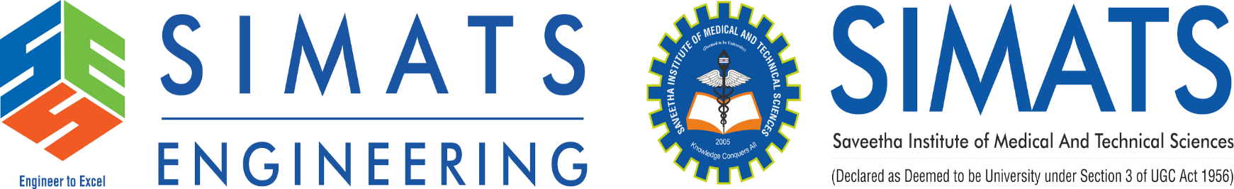
Title
Syntax Checker for Student Coding Assignments
Supervisor Research Scholar
Dr . G. Michael N.Chanakya
Professor 192211040
Saveetha School of Engineering Saveetha School of Engineering

Slide 2
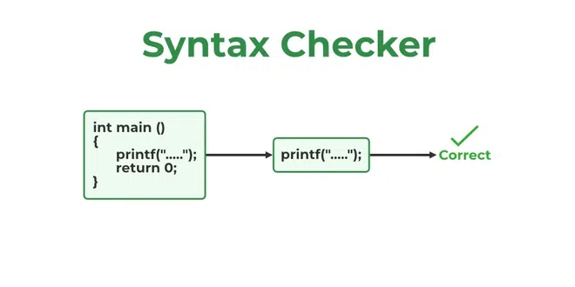
Introduction
What is a Syntax Checker?
A syntax checker is a tool that analyzes code for syntax errors before execution.
It helps students identify mistakes in their code early, improving learning efficiency.
Why is it needed for student coding assignments?
Enhances code quality and debugging skills.
Helps instructors automate code evaluation.

Slide 3
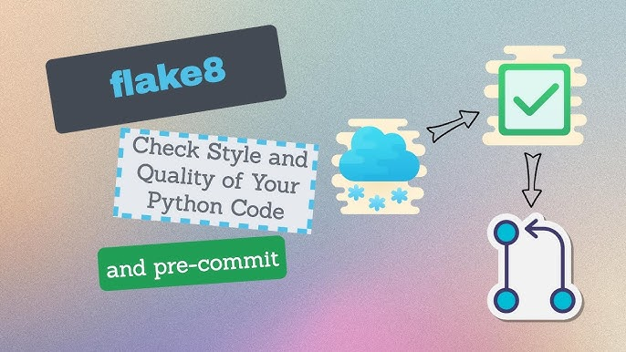
Existing Models
Popular syntax checkers: PyLint, ESLint, Flake8
Integrated Development Environment (IDE) features
Real-time code analysis and debugging suggestions.
Online compilers and syntax validation tools
Offer web-based instant feedback for multiple languages.

Slide 4
Flaws in Existing Models
Limited language support
Lack of feedback on logical errors
High false positive or negative rates
Poor integration with Learning Management Systems (LMS)

Slide 5
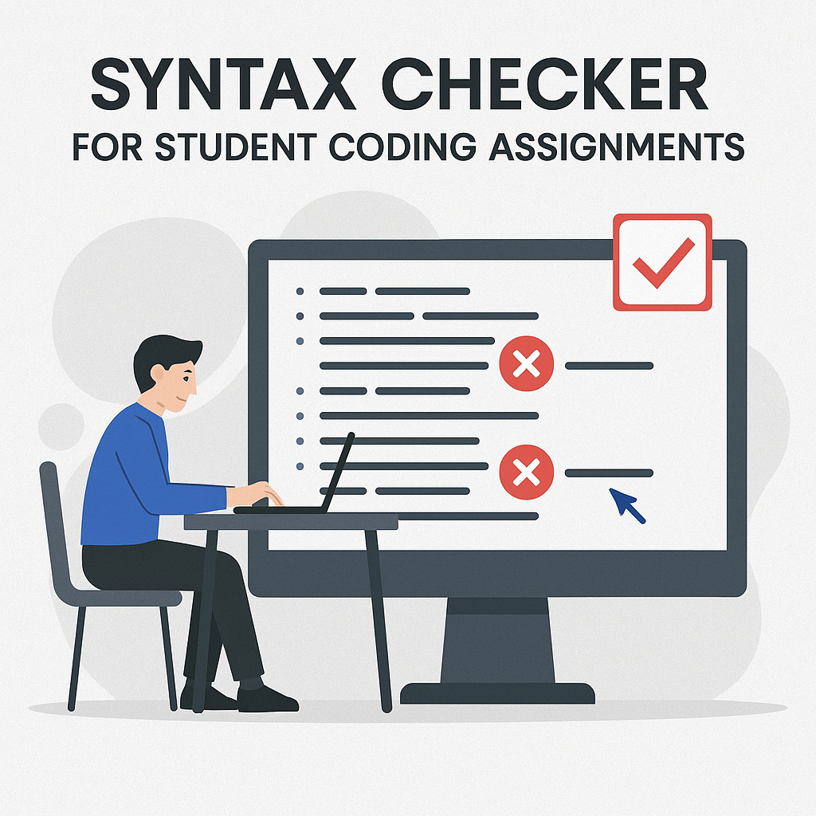
Proposed Model
Supports multiple Programming languages: Python, C++, Java, etc.
Highlights errors and provides suggestions for correction
Reduction in syntax-related mistakes in coding assignments

Slide 6
Implementation Overview
The syntax checker will be developed using a robust technology stack include with C.
Automated grading integration will help instructors save time in evaluating coding assignments
The system will support multiple programming languages to cater to diverse course requirements
The model will be designed to scale and expand with future enhancements and feature additions

Slide 7
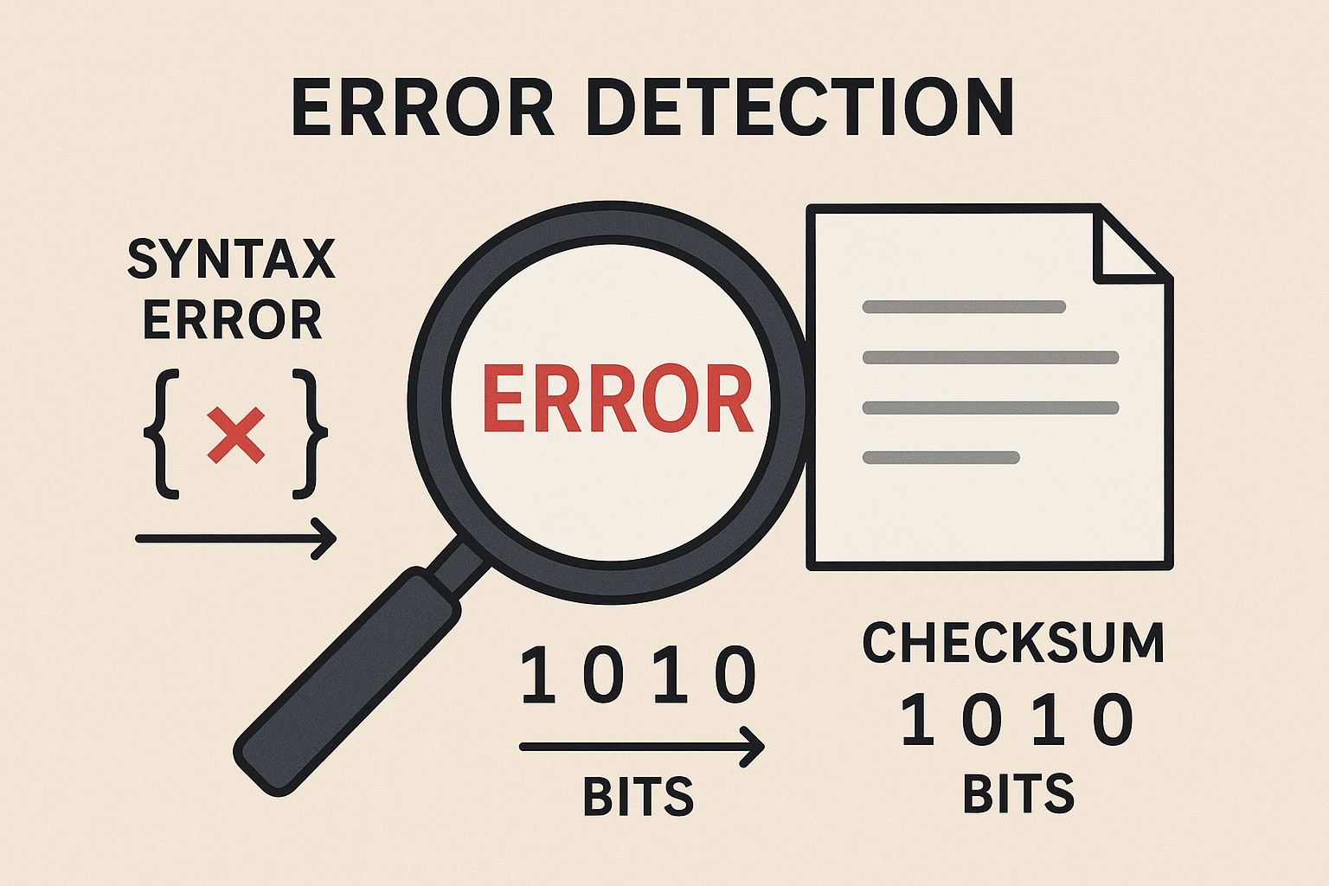
Implementation - Error Detection
The tool will utilize lexical analysis and tokenization to break down the code into meaningful components
An Abstract Syntax Tree (AST)-based validation method will be used to analyze the structure of the code
The system will handle both common syntax errors and rare edge cases efficiently

Slide 8
Results & Discussion
The syntax checker will be compared with existing models to highlight improvements in accuracy and usability
High accuracy of error detection will ensure that students receive precise and meaningful feedback
User satisfaction surveys and feedback will help assess the tool’s effectiveness and areas for improvement
The tool’s impact on reducing common syntax errors will be evaluated through real-world testing

Slide 9
Future Enhancements
The tool will be expanded to support a wider range of programming languages based on demand
Gamification elements such as coding challenges and leaderboards will be added to enhance engagement
Personalized learning experiences will be developed to tailor feedback and suggestions to individual students

Slide 10
Conclusion & Queries
The syntax checker will have a significant impact on both students and educators by improving coding accuracy
Future developments will focus on adding more features and expanding functionality based on user feedback
The session is open for questions and discussions regarding the proposed syntax checker

